Slide 1
Module 4: Advance Git Commands

Slide 2
Identify the different Git commands.
Use some of the key advance Git commands

Slide 3
Topic List
Key Git Commands
Advance Git Commands

Slide 4
Topic List
Key Git Commands
Advance Git Commands

Slide 5
Key Git Commands (1)
List of Key Git Commands
The following table lists the key Git commands and its description:
Creating a work space
clone | Clone a repository into a new directory
init | Create an empty Git repository or reinitialize an existing one
Editing
add | Add file contents to the index
mv | Move or rename a file, a directory, or a symlink
reset | Reset current HEAD to the specified state
rm | Remove files from the working tree and from the index
Analyzing the history and state
bisect | Use binary search to find the commit that introduced a bug
grep | Print lines matching a pattern
log | Show commit logs
show | Show various types of objects
status | Show the working tree status

Slide 6
Key Git Commands (2)
List of Key Git Commands
The following table lists the key Git commands and its description:
Grow, mark and tweak your common history
branch | List, create, or delete branches
checkout | Switch branches or restore working tree files
commit | Record changes to the repository
diff | Show changes between commits, commit and working tree, etc
merge | Join two or more development histories together
rebase | Reapply commits on top of another base tip
tag | Create, list, delete or verify a tag object signed with GPG
Collaborate
fetch | Download objects and references from another repository
pull | Fetch from and integrate with another repository or a local branch
push | Update remote references along with associated objects

Slide 7
Topic List
Key Git Commands
Advance Git Commands

Slide 8

Advance Git Commands
Introduction
Scenario
In this module, requirements of Alex Hopkins are captured and solutions are provided for his requirement. Along with Alex you will also learn the usage of advance Git commands:
Creating Alias
Rebasing
I am using Git for my project.
Merging & Branching
Resetting the files
Hi, I am Alex Hopkins
Identifying the File Status
Finding Difference
Adding File with Selected Changes
Stashing
Committing
Parameters for better logging
Cleaning untracked files and directories
I want to perform certain operations in Git. For my requirements, can you help me with the commands
Git Bisect & Blameon
Alex Hopkins

Slide 9
Creating Alias
Scenario
Alex wants to create an alias for most frequently used command based on the history of commit. He creates an alias by using the following command to save his writing time.
git config –global alias.XZ
Example
git config --global alias.X "log --oneline --graph"
After creating alias the command can be as follows.
git X instead of git log --oneline --graph.
If more parameters to the alias then git X --author=“Charles“
Notes:
Another alternative, is good old Bash alias.
For example, I have the following entry in my .bashrc file.
alias gil=”git log –online –graph”, allowing me to use gil instead of the long command,which is even 2 character shorter than having to type git l :).
TLDR; Use git or bash aliases for most commonly used long git commandsGit comes with built in aliases, for example you can run the following command once:
Another handy trick, for stashing only some of the files, is to:
add the files that you DO NOT want to get stashed (i.e. git add file1.js, file2.js)
Call git stash --keep-index. It will only stash files that have not been added.
Call git reset to un-stage the added files and continue your work.

Slide 10
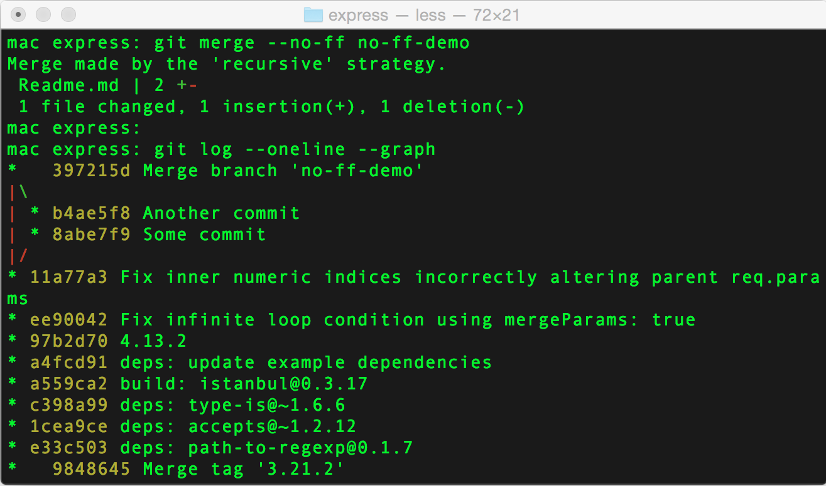
Merging & Branching (1)
Scenario
Alex developed some code in his local branch. He wants to merged the changes to an another branch. He wants to keep the Git branch history during a pull request, even after merging his local branch with another.
Merge Command
Merge command joins two or more development histories together. To merge the histories together, go to the branch to which you need to merge and use the following command:
git merge some-branch-name
The following command helps to store a commit history tree where the branch changes are tracked.
git merge --no-ff
git merge --no-ff some-branch-name.
Alex needs to remember the branch structure after a local merge which is difficult.
How will Alex know the branching details?
Notes:
I like to create a new branch for every new bug or feature. Among other benefits, it helps me to get a great clarity on how a series of commits may relate to a particular task. If you ever merged a pull request on github or a similar tool, you will in fact be able to nicely see the merged branch history in git log --oneline --graph view.

Slide 11
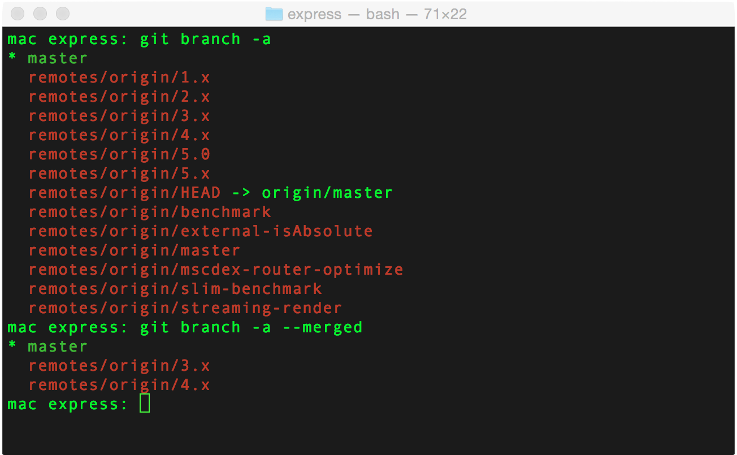
Merging & Branching (2)
Branch Command
To view all the remote branches, use the following command:
To display branches which are fully merged with the master branch, you can use the following command:
git branch –a
git branch -a –merged
Notes:
You can see all of the remote branches by running git branch with the -a flag (show all branches) and the --merged flag would only show branches that are fully merged into the master branch.
You might want to run git fetch -p (fetch and purge old data) first, to make sure your data is up to date.

Slide 12
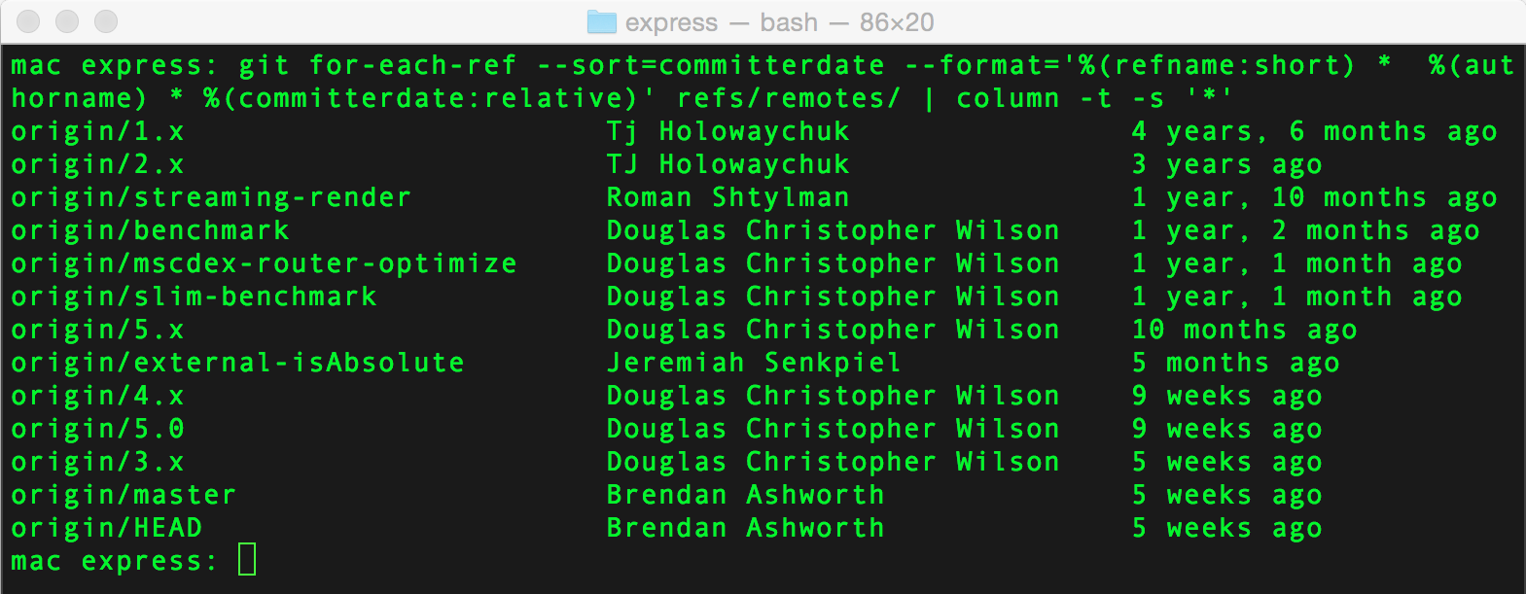
Merging & Branching (3)
Sort Command
Use the following command for viewing the remote branches, that exists along with the last commits.
git for-each-ref --sort=committerdate --format='%(refname:short) * %(authorname) * %(committerdate:relative)' refs/remotes/ | column -t -s '*'
Alex has the details about the remote branches. How can he extract files from those remote branches?

Slide 13
Merging & Branching (4)
Extracting Files from Branches
To extract files from other branches, use the following command:
git show some-branch:file.js
To redirect the output to a temporary file, which can be deleted later, use the following command:
git show some-branch-name:file.js > deleteme.js
Notes:
Sometimes it is nice to take a pick at an entire file on a different branch, without switching to this branch.
You can do so via git show some-branch-name:some-file-name.js, which would show the file in your terminal.

Slide 14
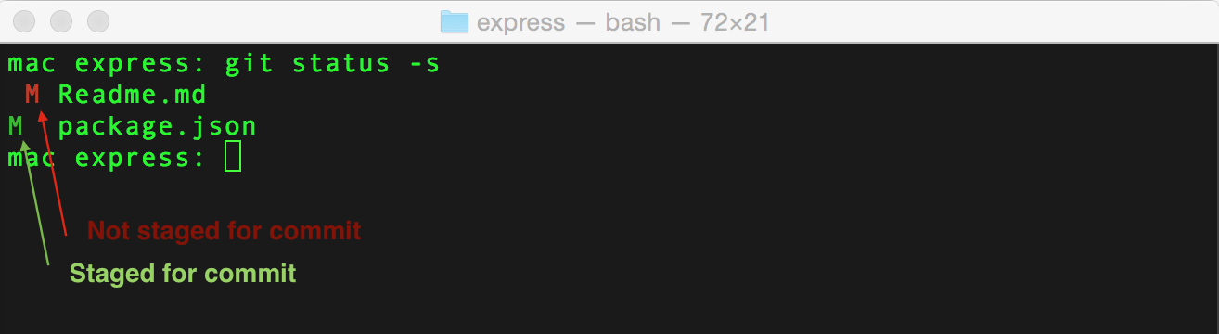
Identifying the File Status
Scenario
Alex has his local files with similar names. He has forgotten what was the last action taken on those files. He wants to display which stage is a file in Git.
To identify the file status, use the following command:
git status -s
Remember
Following are the difference status of the file:
1. Yet to be staged for commit 2. Staged for commit 3. Committed
Notes:
You can see a long description of the files and state they are in by running git status. You move a file from “not staged for commit” stage to “staged for commit” stage, by running git add filename.js or git add . to add all files at once.
Another view that makes it much easier to visualize the stages is invoked via git status -swhere -s stand for short (I think), and would result in an output that looks like that:
Obviously, git status will not show files that have already been committed, you can use git log to see those.

Slide 15
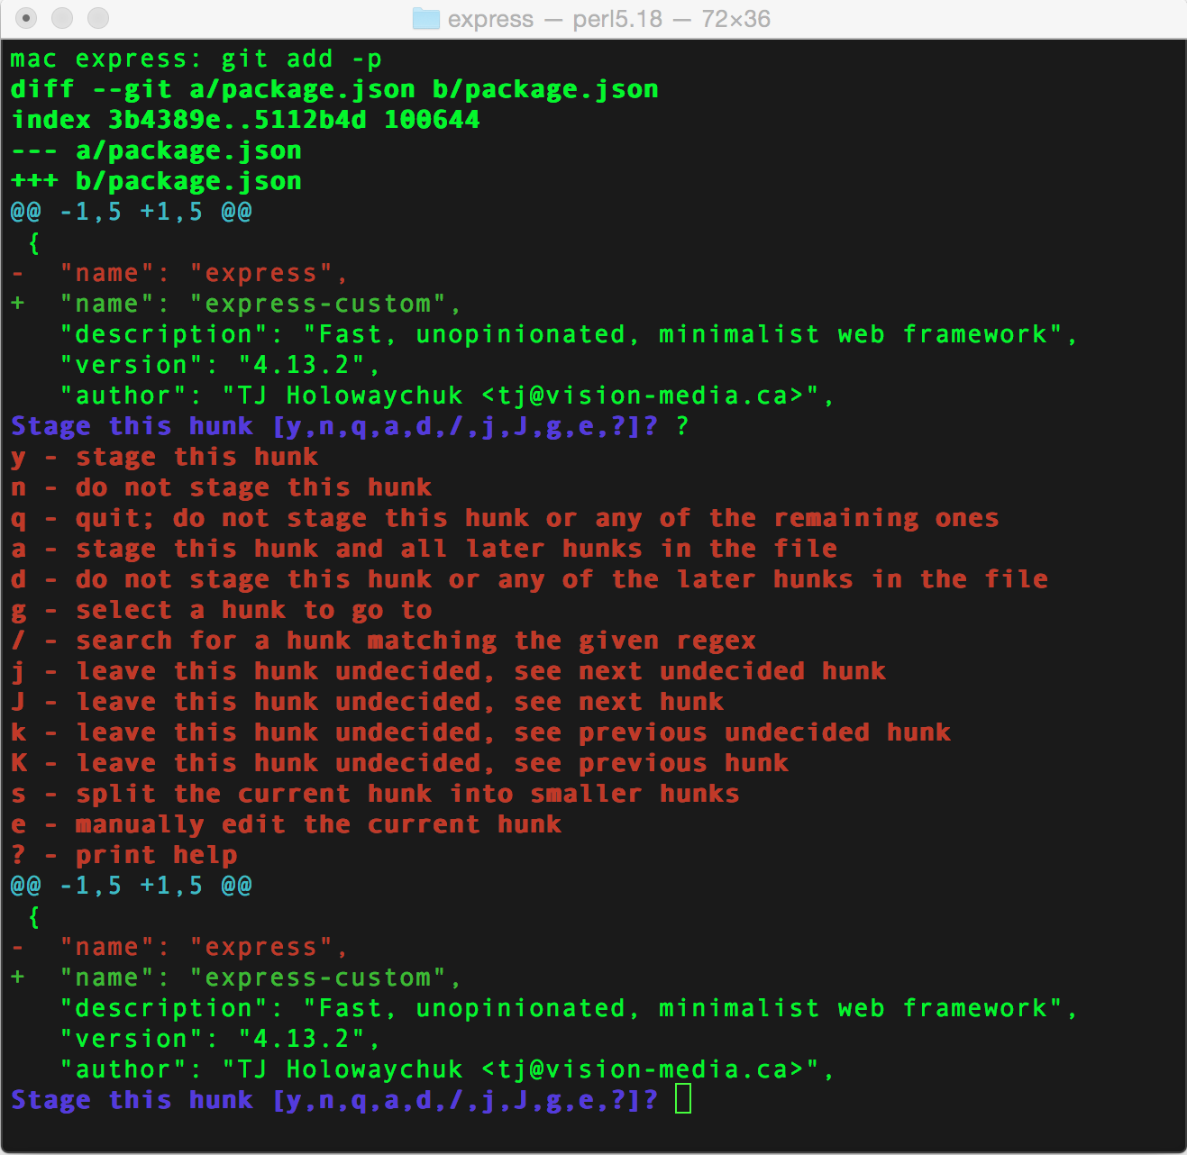
Adding File with Selected Changes
Scenario
Alex finds a file which is yet to be staged, however in that file, he wants to add only selected changes from a file.
To add a file with selected changes, use the following command:
git add -p
Notes:
Somebody at git must really like the -p flag, because it always comes with some handy functionality.
In case of git add, it allows you to interactive select exactly what you want to be committed. That way you can logically organize your commits in an easy to read manner.

Slide 16
Commit (1)
Scenario
Alex added and committed the selected changes. However, he realizes that there is a typo after committing. He wants to correct the typo in his previous commit, instead of making a new commit with comments as “typo”.
When the changes are not pushed to the remote branch, you can use amend option:
Stage the fixed file using the following command:
Execute the following “amend” command through which the most recent changes can be added to the latest commit. Even the commit message can be edited.
git add corrected-file.js
git commit --amend
Important
It is recommended to avoid a new commit, instead of fixing an old commit.
How will Alex fix the typo error if the changes are already Pushed to remote branch?

Slide 17
Commit (2)
Scenario
When the changes are pushed to the remote branch. You can use force option to fix the incorrect commit.
The following command is used to fix the incorrect commit:
git push -f
Note: When you are performing this task, you would be changing the content on a branch that is being used by other users.

Slide 18
Commit (3)
Standards for Commit Message
A commit should describe the following sentence:
When applied, this commit will: {{ YOUR COMMIT MESSAGE}}
Example
When applied this commit will Update README file
When applied this commit will Add validation for GET /user/:id API call
When applied this commit will Revert commit 12345
Soft revert on a commit options are available at
This reverts now and re-commit reverted files and takes the new commit message as an input.
git revert –n

Slide 19
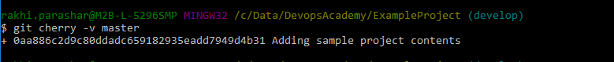
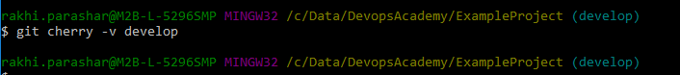
Commit (4)
cherry Command
The git cherry command finds the commits where are yet to be applied to upstream.
git cherry-pick –v SampleBranchName
Git cherry –v master
cherry-pick Command
The git cherry-pick command applies the changes introduced by some existing commits.
git cherry-pick <commitSHA>

Slide 20
Rebasing (1)
Scenario
Alex commits in a local version of a master branch. Simultaneously, another user Tom checked in 5 days of work into the master branch.
By using Push & Pull command, the scenario can be handled
When the user attempts to push, Git identifies the conflicts and it prompts to perform Git pull to resolve it.
After doing Git pull, Git throws a message “Merge remote-tracking branch ‘origin/master‘”, which might clutter the log history a bit.
Using Rebase Command
Alternatively, to address the considered scenario, you can use the following command:
git pull --rebase
The rebase command forces Git to pull the changes first, and then re-apply (rebase) the un-pushed commits on the remote branch’s latest version. Thus the merge and the message is avoided.

Slide 21
Rebasing (3)
Merging Branch with Master
Rebase command is an alternative to Merge command. You can rebase the feature branch with master branch using the following commands:
These commands move the entire feature branch to begin from the master branch and it incorporate all new commits in master.
Rebasing re-writes the project history by creating brand new commits for each commit in the original branch.
The major benefit of rebasing is:
Cleaner project history
Elimination of unnecessary merge commits required by git merge command
Provides linear project history
Easier navigation in the project
git checkout feature
git rebase master

Slide 22
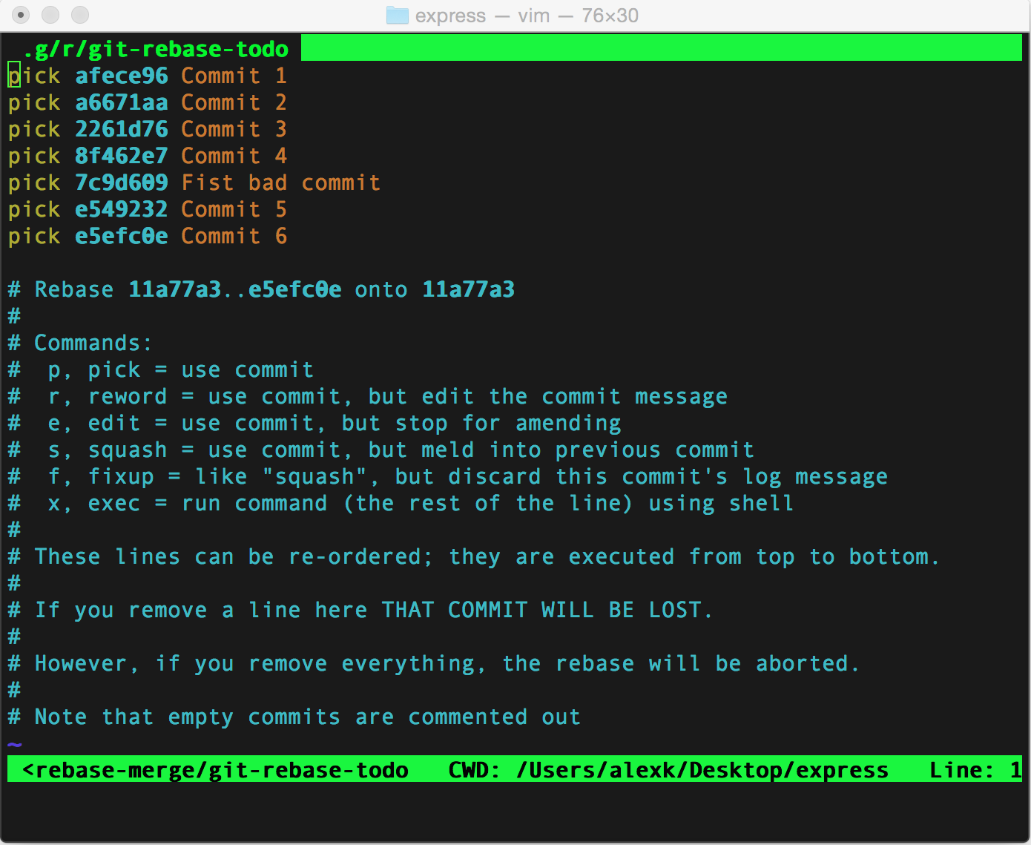
Rebasing (2)
Interactive Rebasing
If you are in need of an interactive rebasing, use the following command:
The command reapplies commit on top of another base.
Note: It is recommended not to use rebase commits that exist outside the repository.
git rebase -i {{some commit hash}}
git pull –rebase
Notes:
https://git-scm.com/book/en/v2/Git-Branching-Rebasing#The-Perils-of-Rebasing

Slide 23
Resetting the Files (1)
Types of Resets
You can use the Reset command to return to a particular version in Git history. Reset command lets you tidy up code before doing commit
Command | Description
git reset --hard {{some-commit-hash}} | Changes made after the commit are discarded.
git reset {{some-commit-hash}} | Changes made after commit are moved to “not yet staged for commit” stage. If needed, run Git add and Git commit to add the files back to the repository.
git reset --soft {{some-commit-hash}} | Changes made after the commit are moved to “staged for commit” stage. You can run Git commit command to add files back to the repository.
Notes:
Common use cases that I find myself using the reset are bellow:
I want to forget all the changes I’ve made, clean start – git reset --hard HEAD (Most common)
I want to edit, re-stage and re-commit files in some different order – git reset {{some-start-point-hash}}
I just want to re commit past 3 commits, as one big commit – git reset --soft {{some-start-point-hash}}

Slide 24
Resetting the Files (2)
Scenario
Alex wants to Ignore local changes for few files, but at the same time he wants to save the changes in few other files. He wants to check out committed versions of the files whose changes are to be ignored.
An alternative command is:
To check out another version of a file from other branch or commit.
git checkout filename.js
git reset –hard
Note: But this option is only for some files.
git checkout some-branch-name file-name.js
git checkout {{some-commit-hash}} file-name.js

Slide 25
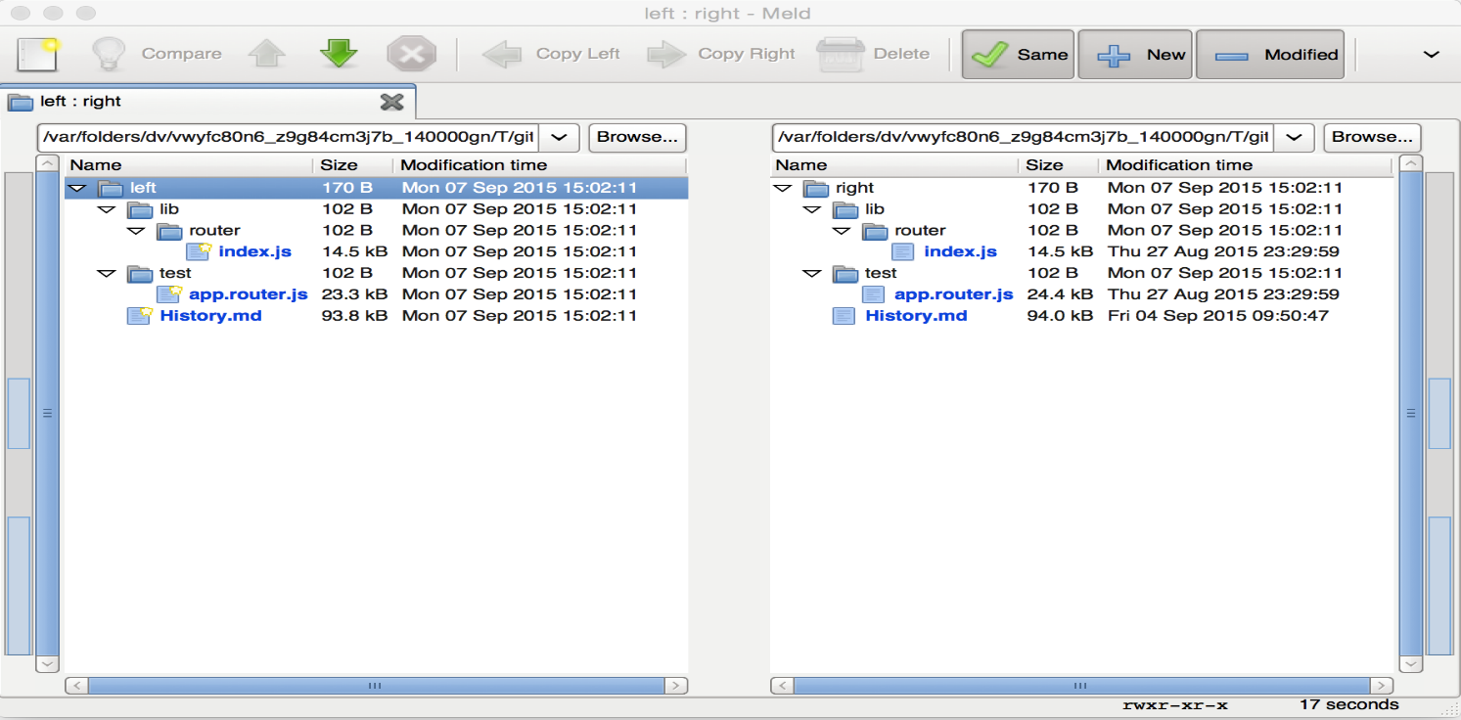
Finding Difference Between Folders (1)
Scenario
Alex wants to find the difference between the folders. You can use the “difftool” command to find the difference between folders.
git difftool –d

Slide 26
Finding Difference Between Folders (2)
Finding Difference Between Files
To find the difference between two files, use the following command:
git diff some-branch some-filename.js
Alex wants to ignore the white space during re-indentation or re-format of a file. How will he do this?
Ignore the white space
To ignore the white space changes during re-indentation or re-format of a file, use the following command:
git diff -w or git blame –w

Slide 27
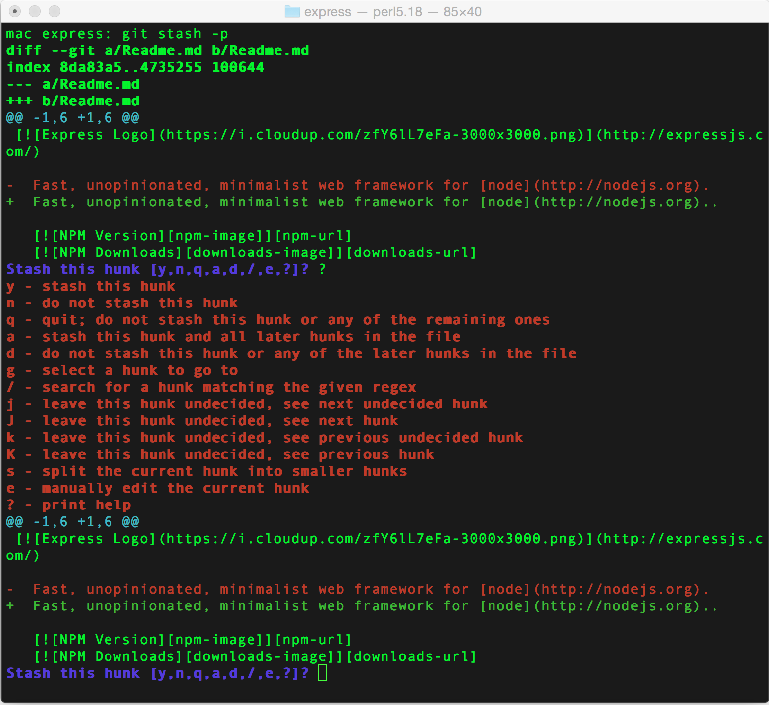
Stashing (1)
Scenario
Alex wants to pull all the unsaved changes on Git Stack.
You can put all the unsaved changes on a “Git stack” using the “stash” command.
git stash -p
-p option allows you to see the chunks of changes that needs to be stashed.
You can use the stash command when you want to record the current state of the working directory and the index, but want to go back to a clean working directory.
The command saves the local modifications and reverts the working directory to match the HEAD commit.
Notes:
If you don’t yet know what git stash does, it simply puts all your unsaved changes on a “git stack” of sorts. Then at a later time you can do git stash pop and your changes will be re-applied. You can also do git stash list to see all your stashed changes.
One limitation of regular git stash is that it will stash all of the files at once. And sometimes it is handy to only stash some of the file, and keep the rest in your working tree.

Slide 28
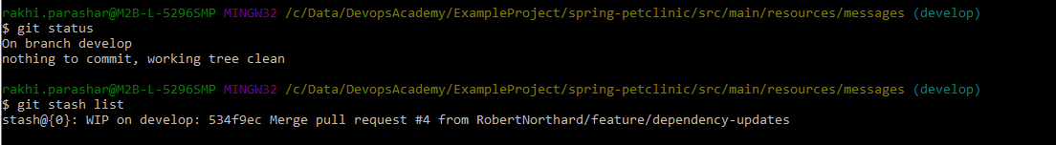
Stashing (2)
Stash Command Options
Stash list
Stash pop
git stash list
Lists the current stash entries that you have. List command displays the following:
A named stash entry (e.g. stash@{0} which will the the latest entry, stash@{1} is the one before, etc.),
A short description of the commit the entry was based on.
git stash pop
Removes a single stashed state from the stash list and apply it on top of the current working tree state.
Notes:
Stash pop
Remove a single stashed state from the stash list and apply it on top of the current working tree state, i.e., do the inverse operation of git stash save. The working directory must match the index.
Applying the state can fail with conflicts; in this case, it is not removed from the stash list. You need to resolve the conflicts by hand and call git stash drop manually afterwards.
If the --index option is used, then tries to reinstate not only the working tree’s changes, but also the index’s ones. However, this can fail, when you have conflicts (which are stored in the index, where you therefore can no longer apply the changes as they were originally).
When no <stash> is given, stash@{0} is assumed, otherwise <stash> must be a reference of the form stash@{<revision>}.

Slide 29
Parameters for Logging (1)
Scenario
Alex needs a weekly report about the project files which has to be submitted every Friday.
On Fridays, he needs to execute following command:
Following table lists the parameters that can be passed on with the log command:
git log --author="Alex Hopkins" --after="1 week ago" –oneline
Parameters | Description
author=“Alex Hopkins" | Show commits made by a particular author
name-only | Only file names are displayed.
oneline | Data is compressed to one line.
graph | Displays the tree of dependency for all commits.
reverse | Commits in reverse order (Oldest commit first).
after | Filters and displays commits done after particular date.
before | Displays commits before particular date.

Slide 30
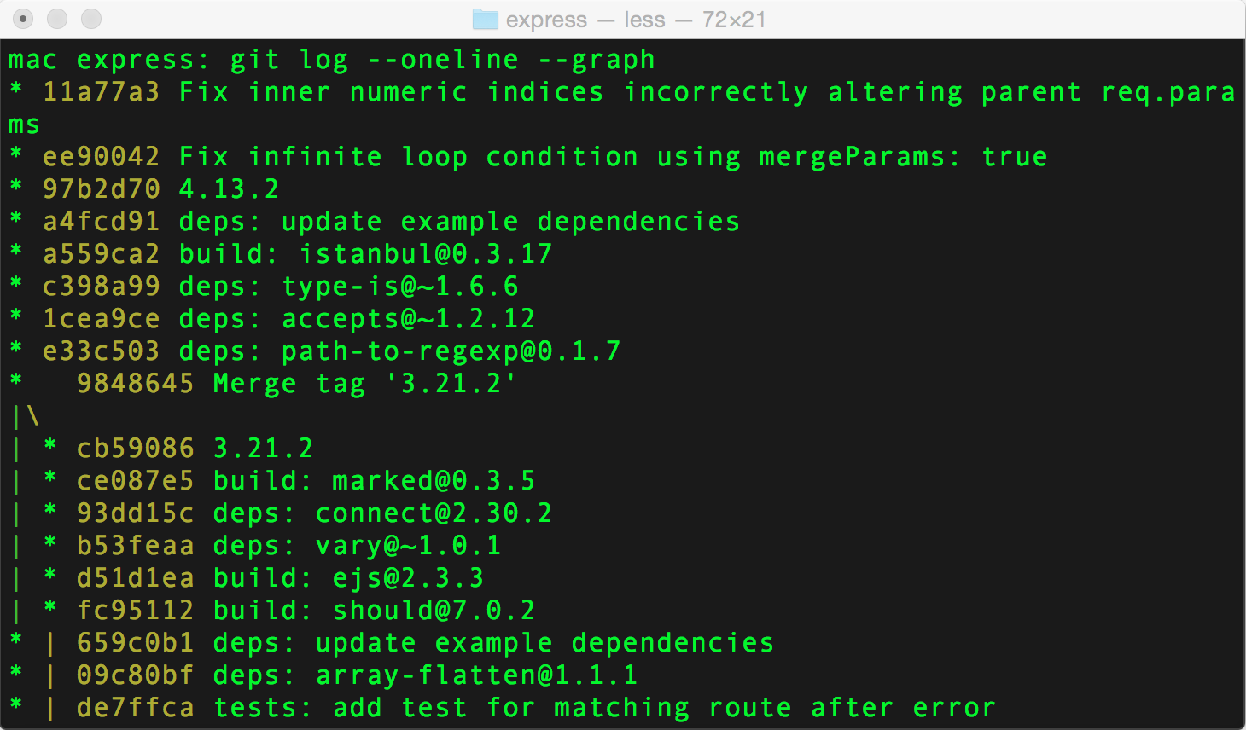
Parameters for Logging (2)
Example
Alex wants to have a look at the compressed data as tree of dependency for all commits.
git log --oneline --graph

Slide 31
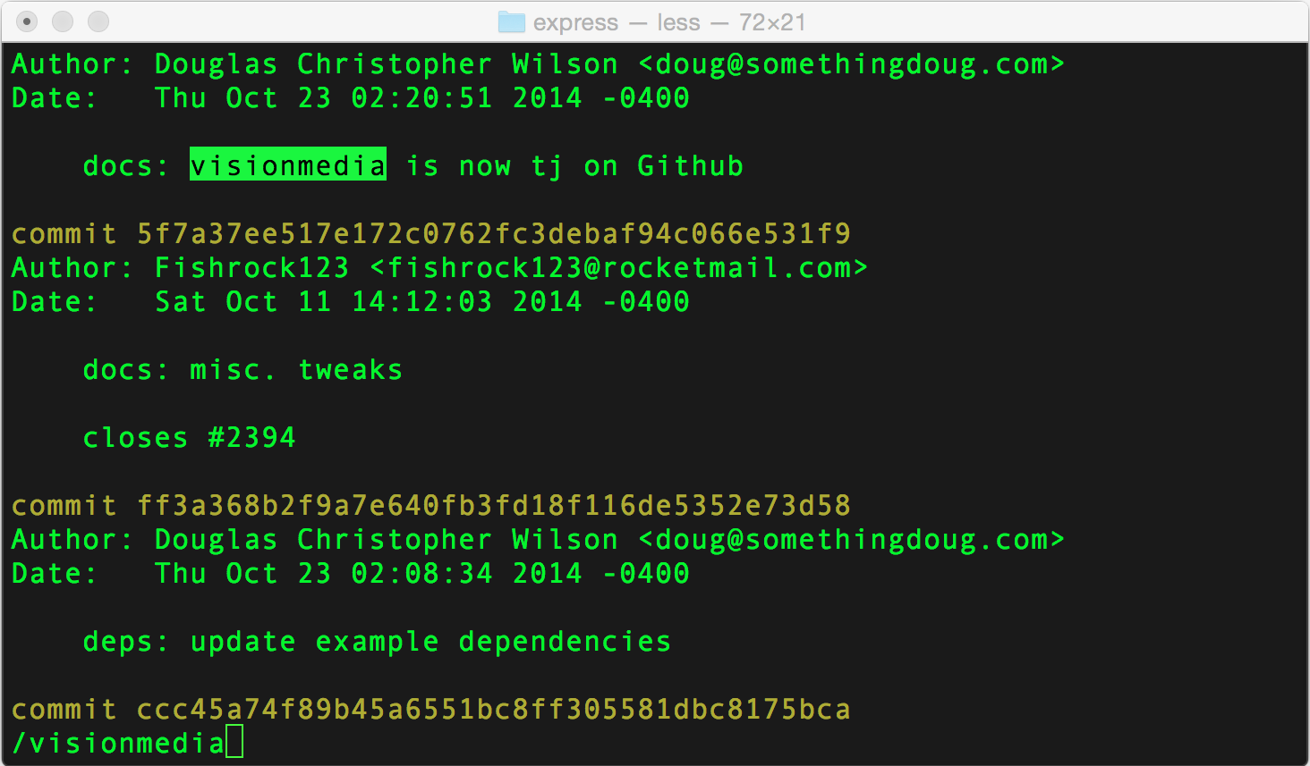
Parameters for Logging (3)
Example
Alex wants to have a look at all the changes that were made in each commit, along with the commit message, author, and date.
git log -p filename

Slide 32
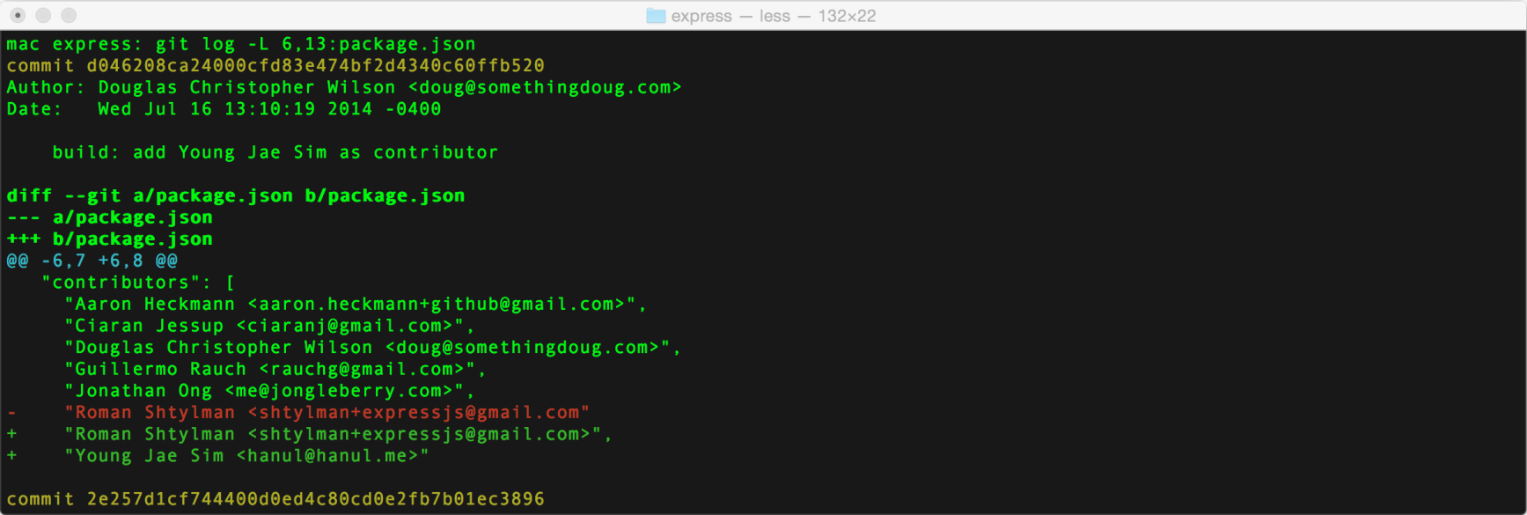
Parameters for Logging (4)
Example
Alex finds something fishy in line 1 of a certain file. He wants to see what has changed in it through various commits.
This traces the evolution of the line 1 to line 1 in the file named “filename” through various commits.
git log -L 1,1:filename
Notes:
It’s kind of like git log -p with focus.
You can use git blame filename to find the person responsible for every line of the file.
git blame is a great tool, but sometimes it does not provide enough information

Slide 33
Parameters for Logging (5)
Example
Alex wants to log the changes that are yet to be merged to the parent branch.
Alternatively,
Also displays file changes which have not been merged yet.
git log --no-merges master
no-merges flag: Displays changes which are not merged to any branch, and the master.
git show --no-merges master
or
git log -p --no-merges master
Notes:
If you ever worked on a long-lived branches, with multiple people working on it, chances are you’ve experienced numerous merges of the parent branch(i.e. master) into your feature branch. This makes it hard to see the changes that took place on the master branch vs. the changes that have been committed on the feature branch and which have yet to be merged. git log --no-merges master.. will solve the issue.

Slide 34
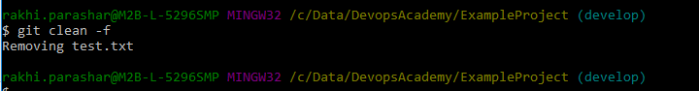
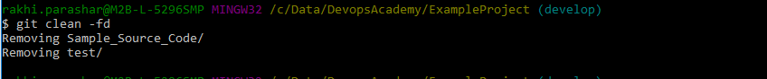
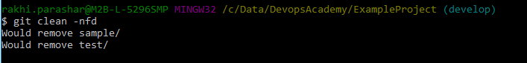
Cleaning Untracked Files and Directories
Scenario
Alex identifies few untracked files and directories in the project which he wants to remove.
Following are the commands to remove untracked files and directories:
Git clean –f
Removes untracked
files
Git clean –fd
Removes untracked files/directories
Git clean –nfd
Lists all files and folders which will be removed

Slide 35





Git Bisect & Blameon (1)
?
?
?
?
?
Alex went on a planned vacation.
Alex headed back to work. He pulled the latest changes of the feature that he worked prior to vacation and noticed that the work is left cracked.
On checking the last commit before vacation, the left out feature is intact and is operational.
Numerous commits exist after he left for vacation.
Found bugs in the feature that he was working.
Now, how will Alex fix the bug and find who broke the feature???
Notes:
If the bug is hard to find, however, you could try to navigate your way through the commit history, in attempt to pin point where the things went bad. The second approach is exactly where git bisect is so handy. It will allow you to find the breaking change in the fastest time possible.

Slide 36

Git Bisect & Blameon (2)
Git Blameon & Git Bisect
Git Blameon command to find out the culprit who broke feature.
Git Bisect command to find the broken commit that caused the bug by using the divide and conquer algorithm.
$ git bisect
Git Bisect Conquer Algorithm
A known bad commit and a known good commit are mentioned to Git Bisect.
This splits the commits between those in half, thus identifies the middle one and checkout a new (nameless) branch.
Alex should check whether the feature is broken in the middle commit.
If the middle commit is operational and not broken, then repast Git bisect with this known good commit and the known bad commit.
This process gets narrowed down and thus the first bad commit which broke the feature is spotted.
Notes:
Since you divide the number of commits by half on every iteration, you are able to find your bad commits in log(n) time (which is simply a “big O” speak for very fast).

Slide 37
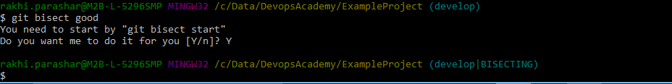
Git Bisect & Blameon (3)
Git Bisect Command Example
Following screen captures shows an example of Git Bisect command.

Slide 38

Knowledge Check
Select the right answer
Which command is used to find the broken commit that causes the bug?
git log
git bisect
git blameon
git checkout

Slide 39
Knowledge Check
Select the right answer
Which command saves the unsaved changes on a “Git stack”?
Clone
Add
Commit
Stash

Slide 40
Exercise 4.1: Using Git Advance Commands
Scenario
Create a branch devTest, pull the changes from the master branch over here and then make some more changes, save those changes and then commit your changes. Go to develop branch and then merge the changes of devTest branch in develop branch.
Compare both the branches develop and devTest with master, if any file is missing from the master then fetch that file and place in both branches (develop and devTest). Use commands like grep, log, show, status, diff and bisect for analyzing history.
Add a new file in the working tree and make the changes and commit. Post this copy this file to another file File2 and then rename the newly added file. Finally remove the File2 from the working tree. Check status of the working tree.
Clone the spring petclinic project from git repository. Go to spring-petclinic/src/main/resources/messages/messages.properties and remove the first line with content "welcome=Welcome". OR you can create any other bug and commit the changes. Now use binary search to find the commit that introduced a bug. Hint: use Bisect and blame command.

Slide 41
Exercise 4.2: Using Git Advance Commands
Scenario
Following are the key scenarios where you need to use some of the other Git Advance Commands:
Creating an alias for most frequently used command based on the history of commit.
Identifying the file status by displaying which stage is a file in Git
Merging without using merge command
Keeping the changes in local branch that you want to commit later.
Committing only specific commits from master to your current
Removing untracked files and directories

Slide 42
Identify the different Git commands.
Use some of the key advance Git commands

Slide 43
Describe Configuration Management (CM).
Explain what is Git.
Practice the steps to create Git Hub Repository.
Use some of the key Git commands for version control.

Slide 44
Thank You

